Slide 1
Numpy and Tensorflow Tutorial
11/16/2018

Slide 2
Scientific Computation Softwares
Numpy
Matrix computation
Tensorflow
Computational graph for machine learning
Jupyter Notebook
Interactive and multimedia python development environment
Google Colaboratory
Online Jupyter notebook with popular software already on the shelf

Slide 3
Brief of problem 2 of Homework 5
Using jupyter notebook(Colaboratory)
About 20 lines of python codes focusing on:
Forward and backward propagation
Gradient updating
Some steps of training operation
Compared with problem 1, it’s a more formal and complete neural network, consisting of modularized layer, model, and training workflow.

Slide 4
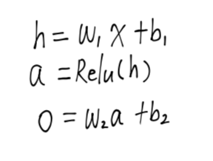
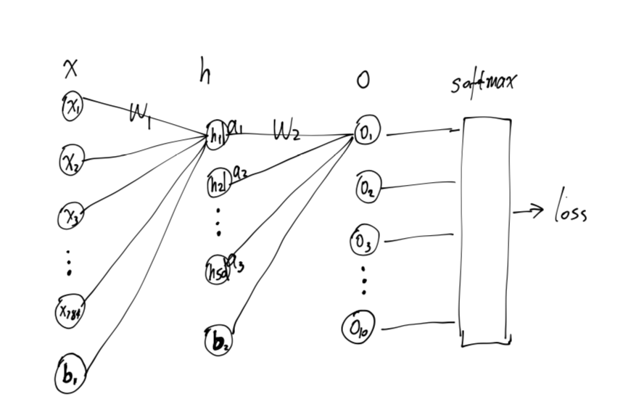
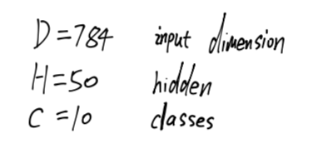
The two layer model

Slide 5
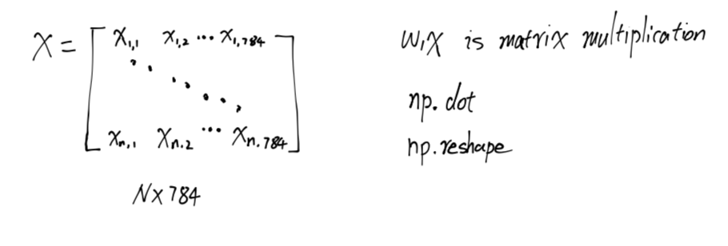
Forward Propagation

Slide 6
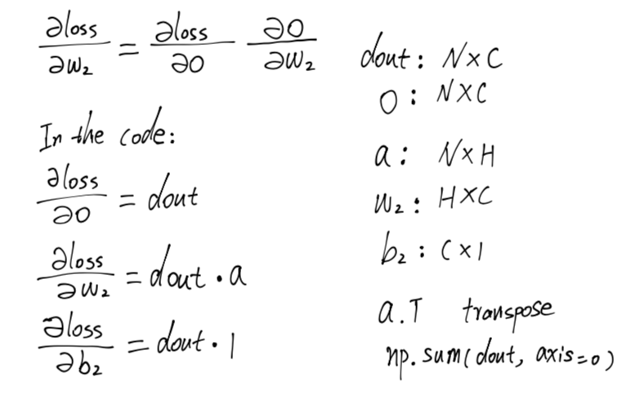
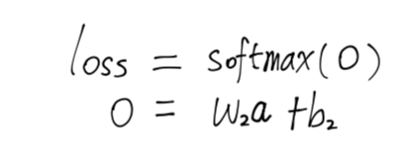
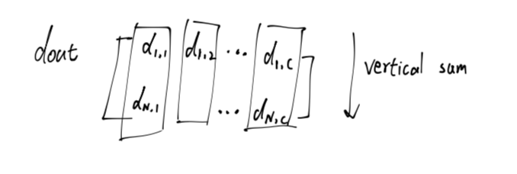
Backpropagation

Slide 7
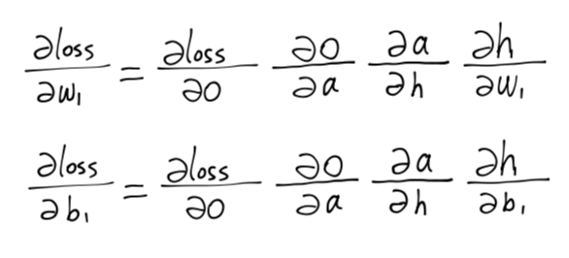
Backpropagation

Slide 8
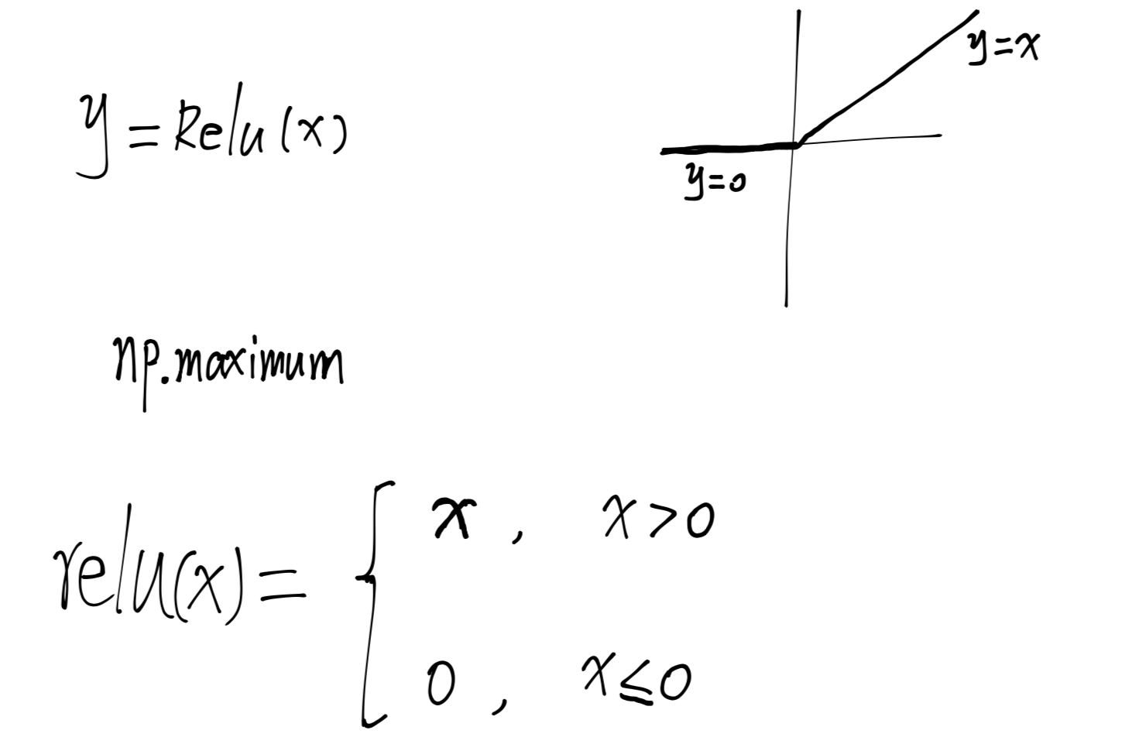
Relu backpropagation

Slide 9
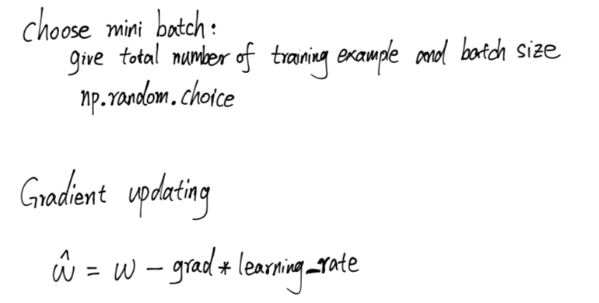
Miscellaneous

Slide 10
Tensorflow
TensorFlow™ is an open source software library for high performance numerical computation. Its flexible architecture allows easy deployment of computation across a variety of platforms (CPUs, GPUs, TPUs), and from desktops to clusters of servers to mobile and edge devices.
Why use it:
Computational graph for defining model, easier for parallel processing
Automatic differential, which means automatic backpropagation
Not just for neural network optimization

Slide 11
Low level API
Parallelism: by using explicit edges to represent dependencies between operations, it is easy for the system to identify operations that can execute in parallel.
Distributed execution: by using explicit edges to represent the values that flow between operations, it is possible for TensorFlow to partition your program across multiple devices (CPUs, GPUs, and TPUs) attached to different machines. TensorFlow inserts the necessary communication and coordination between devices.
Portability: the dataflow graph is a language-independent representation of the code in your model. You can build a dataflow graph in Python, store it in a SavedModel, and restore it in a C++ program for low-latency inference.

Slide 12
High level API
https://colab.research.google.com/github/tensorflow/docs/blob/master/site/en/tutorials/_index.ipynb

